Slide 1
Why Concurrency
Concurrent Programming with C# Nikolay Pavlov

Slide 2
When It All Started
Processors had scalar architecture
Hence, programs were linear
Human thinking is linear

Slide 3
The Free Performance Lunch
Moore’s law: 4.77MHz → 20MHz → 66MHz → 166MHz → 500 MHz → 1 GHz → 2 GHz → 3 GHz
Memory, Disks are growing cheaper, faster, bigger
Result:
“Andy giveth, and Bill taketh away”
Most existing applications have a single sequence of execution

Slide 4
CPU Performance Improvements
Clock speed
Cache
Execution optimizations
Chip designers are under so much pressure to deliver ever-faster CPUs that they’ll risk changing the meaning of your program, and possibly break it, in order to make it run faster.

Slide 5
Clock Speed Limits
Fact: processor clock speed hit a wall a decade ago:
2004, Pentium IV: 3.8 GHz
2014, Intel Core: 3 – 3.6 GHz
2017, Intel Core: up to 4.0 GHz (for a single core only!)
The wall: thermal dissipation (and not only)

Slide 6
Cache
Cache is very fast memory, much faster than RAM
Cache size will grow with the number of transistors on a die
Cache has actual impact on existing non-parallel applications

Slide 7
Demo: Execution Optimizations

Slide 8
Parallel Execution Optimizations
Execute multiple instructions per clock cycle. CPU checks for data dependencies dynamically
These can be executed:
a = b + c; d = e + f;
These cannot:
a = b + c; d = a + e;

Slide 9
Dangerous Execution Optimizations
This:
void Init()
{
data = 42;
initialized = true;
}
Can become:
void Init()
{
initialized = true;
data = 42;
}

Slide 10
Execution Optimization Summary
Speed up sequential applications
But they are concurrency-agnostic

Slide 11
Near-future Performance Drivers
Hyper-threading
Multicore
Cache
Further optimizations in CPU architectures

Slide 12
Hyper-threading
Run two or more pieces of code in parallel inside a single CPU core
Hardware support: execute another piece of code while the primary is waiting
Software: OS see HT-enabled CPU core as two CPU cores
Little benefit on existing non-parallel applications

Slide 13
Multicore
Add two or more actual CPUs on one chip
Similar to multi-processor systems, but cheaper to produce and build
Speed-ups for non-parallel applications – the OS and other apps are not interrupting
Can even hurt performance for non-parallel applications due to architectural peculiarities (f.e. NUMA)

Slide 14

More Tools

Slide 15
Myths vs. Reality
3 x 2GHz < 6 GHz
Why:
There is coordination overhead between cores / CPUs
Overhead of other hardware designs (like NUMA)
Parallel pieces of code often must wait for one another

Slide 16
What Does It Mean for Us?
Applications will need to be concurrent to fully exploit the CPU throughput gains
Performance optimizations will be come more important, not less
Programming languages and systems will have to adopt concurrency
What we know is often wrong

Slide 17
Concurrency – Next Revolution
Concurrency is the next big thing after OOP
Most programmers don’t understand concurrency

Slide 18
Why Do We Need It?
Build responsive user interface
Make use of otherwise idling CPU
Parallel Programming
Make multiple I/O requests simultaneously

Slide 19
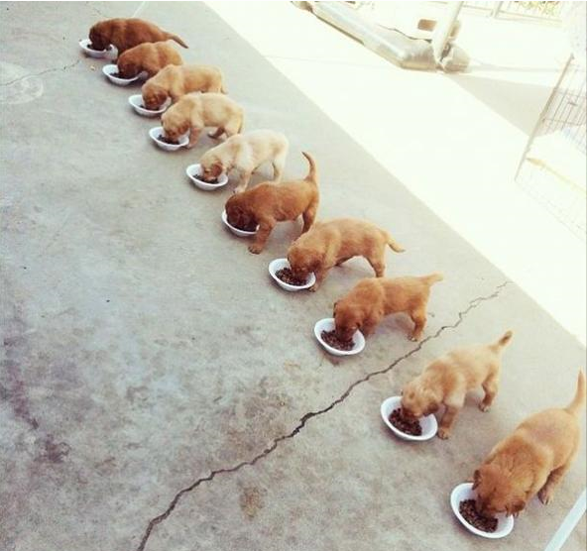
Parallel Programming in Theory

Slide 20

Parallel Programming in Reality

